Slide 1
ACMA 231
VBA:
Intro, the VBE, and Recording Macros

Slide 2
What is VBA?
VBA: Intro
“Visual Basic for Applications”
A programming language built into Excel
  Make sophisticated workbooks
  Write custom functions
What is a macro?
  A collection of code that performs a series of commands
  Very useful when doing repetitive jobs to improve efficiency
  In Excel, macros can be written or recorded
This website has a long list of things you can do with VBA, and tutorials: http://www.excel-easy.com/vba.html

Slide 3
Why use VBA?
VBA: Intro
Automate a manual and repetitive process to save time and eliminate human error

Slide 4

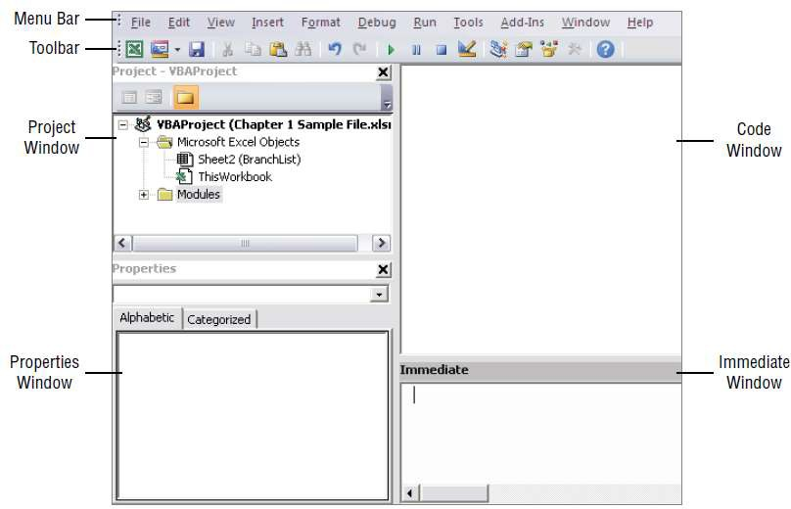
VBA: The Visual Basic Editor

Slide 5
VBA: The Visual Basic Editor
Before you can do anything meaningful, you must have some VBA code in the VBA module. You can get VBA code into a VBA module in three ways:
  Use the Excel macro recorder to record your actions and convert them to VBA code.
  Enter the code directly.
  Copy the code from one module and paste it into another.
Entering the code directly:
Sub | NewMacro()
 | MsgBox "Hello | World"
End | Sub
Name your macro (e.g. NewMacro) and click “Create”

Slide 6
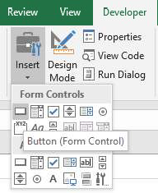
VBA: The Visual Basic Editor
Buttons and other cool things…
Put the button wherever you want and assign it to your new macro.

Slide 7

Using the Excel macro recorder to record your actions and convert them to VBA code:
VBA: Recording a Macro
or
Name your new macro, put in a shortcut key (if you’d like) Do stuff, then push stop.
You can then see the automatically written code and adjust as desired.

Slide 8
Some coding rules and good habits
VBA: Intro
White space is ignored in VBA and the editor will automatically discard any extra spaces.
  Always put a space after a comma, never before, just like in regular English.
  Most infix operators (=, +, -, etc.) should always be surrounded by spaces.
  There are a few exceptions, which should never be surrounded by spaces, for example: power(^), $, @.
Indentation should be used to highlight the block structure and control statements.
  You can use the “Tab” key to indent your lines of code that logically belong together to make the code easier to read.
  The “Tab” key should be used instead of pressing the spacebar multiple times.

